Slide 1

G2M Case Study
By: Amaan Khan

Slide 2
Hypotheses
During this case study, I chose several different theories that I would test out:
Profitability
Preference
Distance Travelled
Average Fare
Age factor

Slide 3
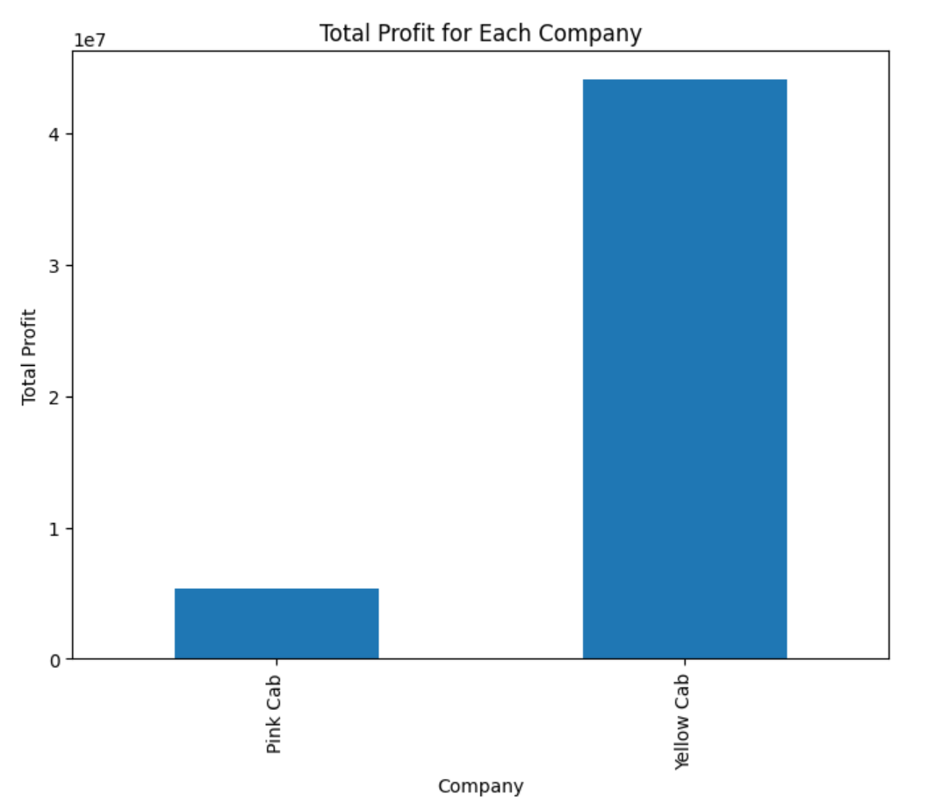
Profitability

Slide 4
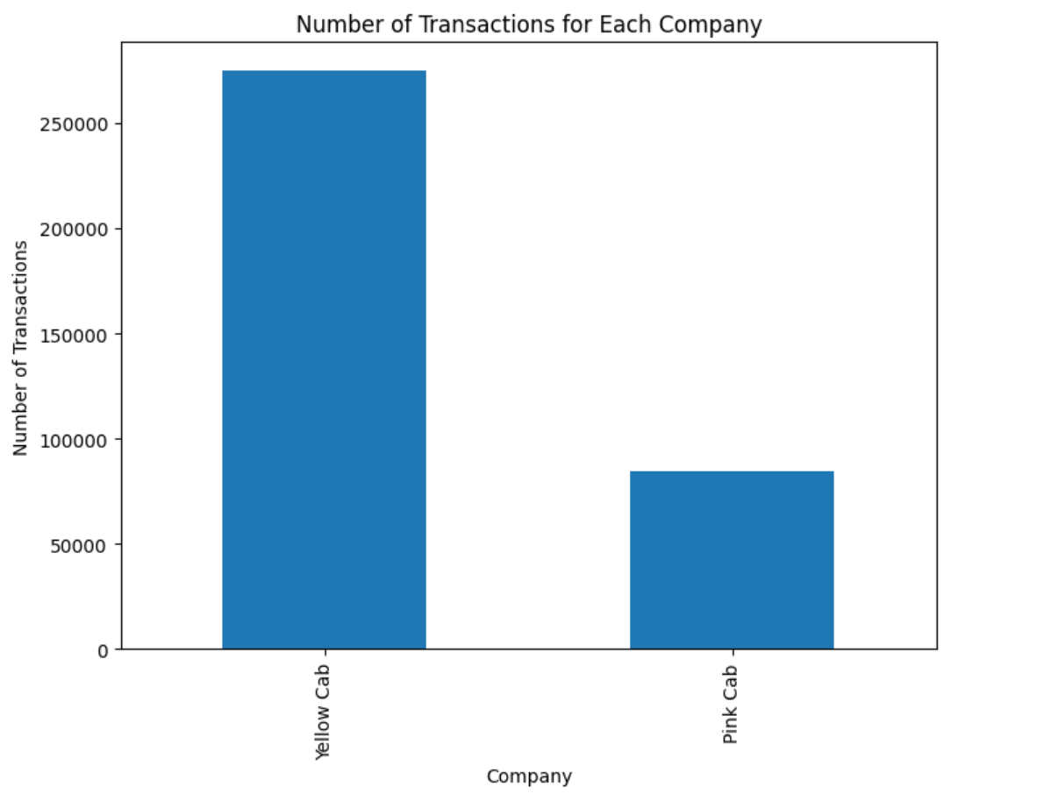
Preference

Slide 5
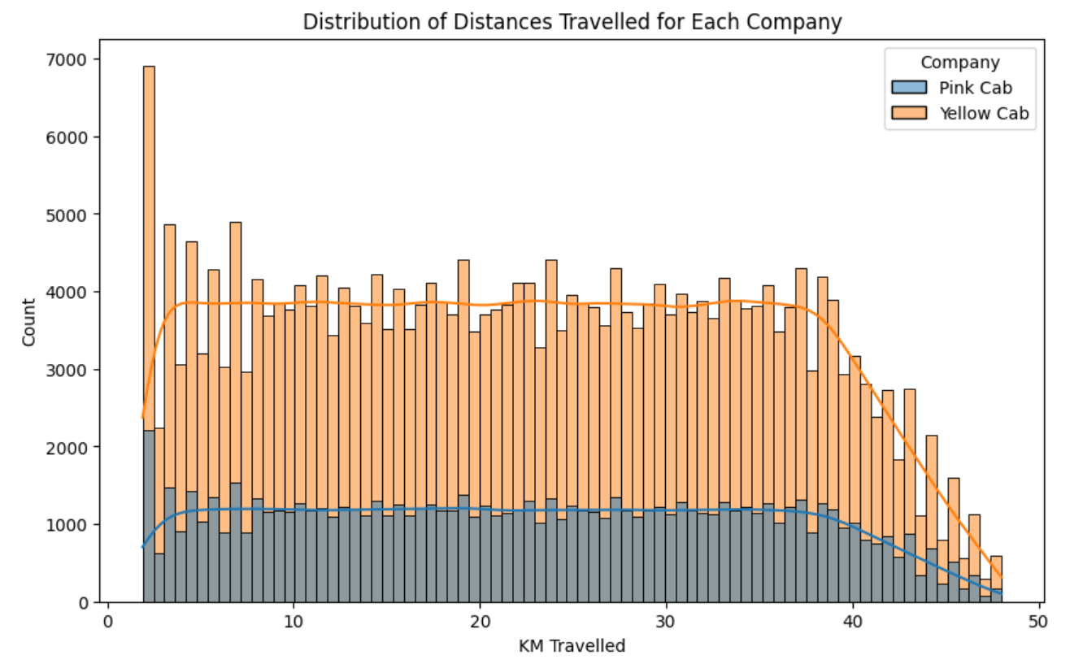
Distance Travelled

Slide 6
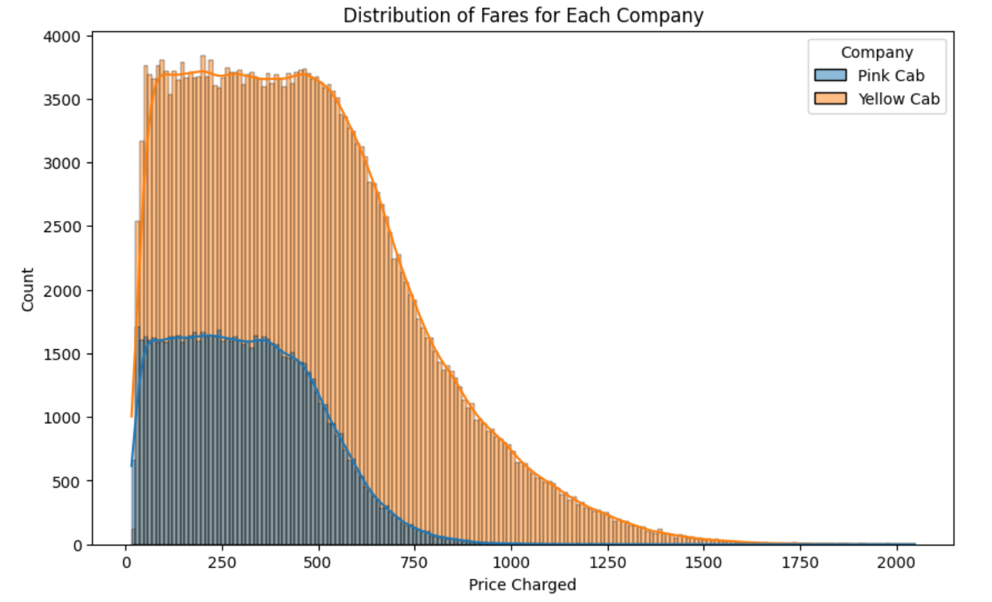
Average Fare

Slide 7
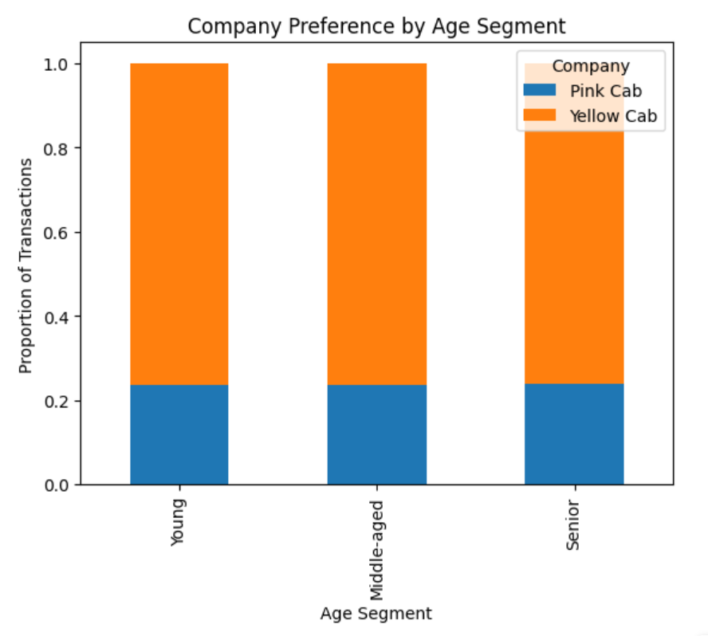
Age

Slide 8
Thoughts
It is clear to me that investing into yellow cab would be the smart decision, as the graphs show this:
Profitability graph shows that yellow cab generates significantly more profit than pink cab
Preference graph shows that yellow cab has much transactions than pink cab, showing that more people prefer yellow cab
Distance travelled graph shows that more people take short distance trips with yellow cab, which is a more common practice when people use cabs
Average fare graph appears to show that yellow cab is more expensive than pink cab, showing that is higher quality
Age graph appears to be neutral here, as it does not seem to affect the two companies.

Slide 9
Ending
Thanks for reading my presentation!

